Slide 1

On behalf of the Arctic Domain Awareness Center (ADAC) and the University of Alaska…
ADAC’s Arctic C-ICE March 16-17, 2021
Welcome Back
to the
2021 Arctic Challenges, Innovations, and Commerce Expo (Arctic C-ICE)

Slide 2
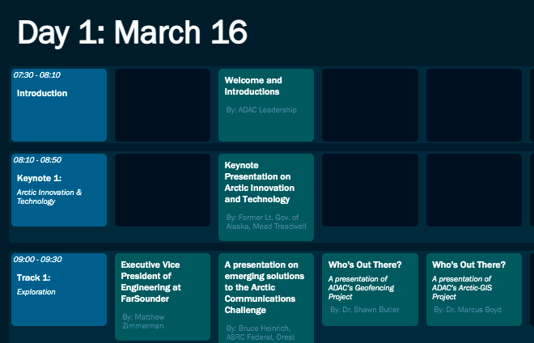
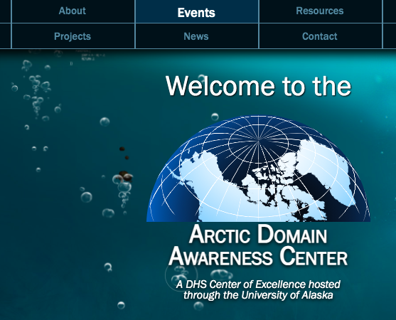

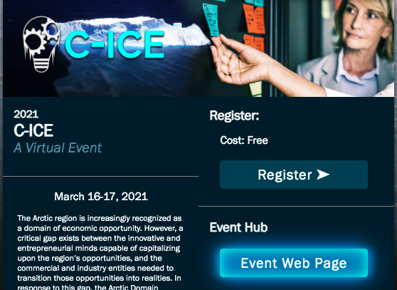
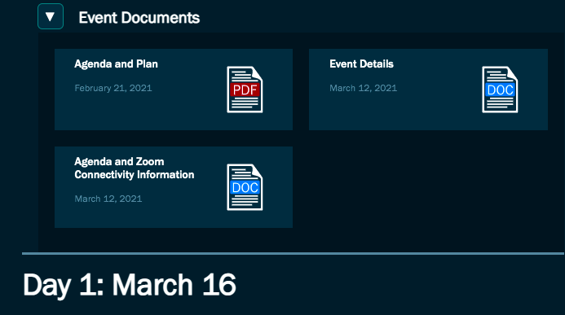
Technical Overview of the Expo
ADAC’s Arctic C-ICE March 16-17, 2021: Day 2
1.
4.
https://arcticdomainawarenesscenter.org
2.
and/or
3.

Slide 3
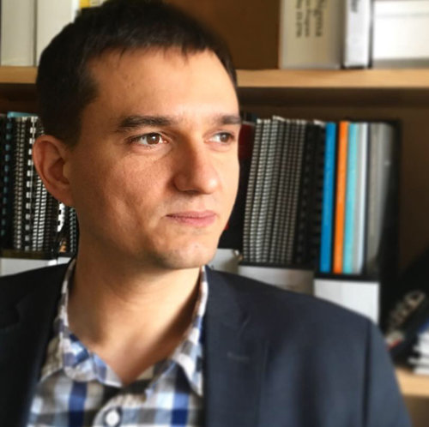

Fireside Chat: Transforming Challenges into Opportunities and Entrepreneurship
Hosted and Presented by…
ADAC’s Arctic C-ICE March 16-17: Day 2
0835-0915 AKDT/1235-1315 EDT
Nolan Klouda
Executive Director of the University of Alaska Center for Economic Development
Ben Kellie
CEO and Founder of The Launch Company

Slide 4
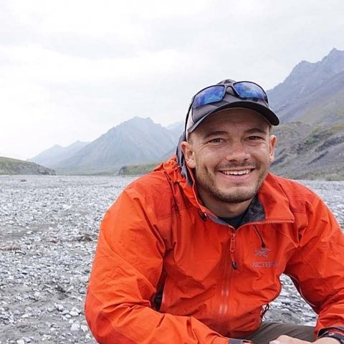

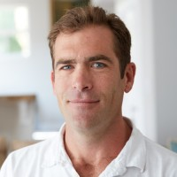
Track #4: The Blue Economy
Hosted and Presented by…
ADAC’s Arctic C-ICE March 16-17: Day 2
0920-1000 AKDT/1320-1400 EDT
Moderator: Taylor Holshouser
Director of Business at the Alaska Ocean Cluster & Research Fellow at the Wilson’s Center Polar Institute
Leslie Canavera
Chief Executive Officer of PolArctic
Peter Macy
Chief Business Officer of Blue Ocean Gear

Slide 5
Break
ADAC’s Arctic C-ICE March 16-17: Day 2
1000-1010 AKDT/1400-1410 EDT

Slide 6
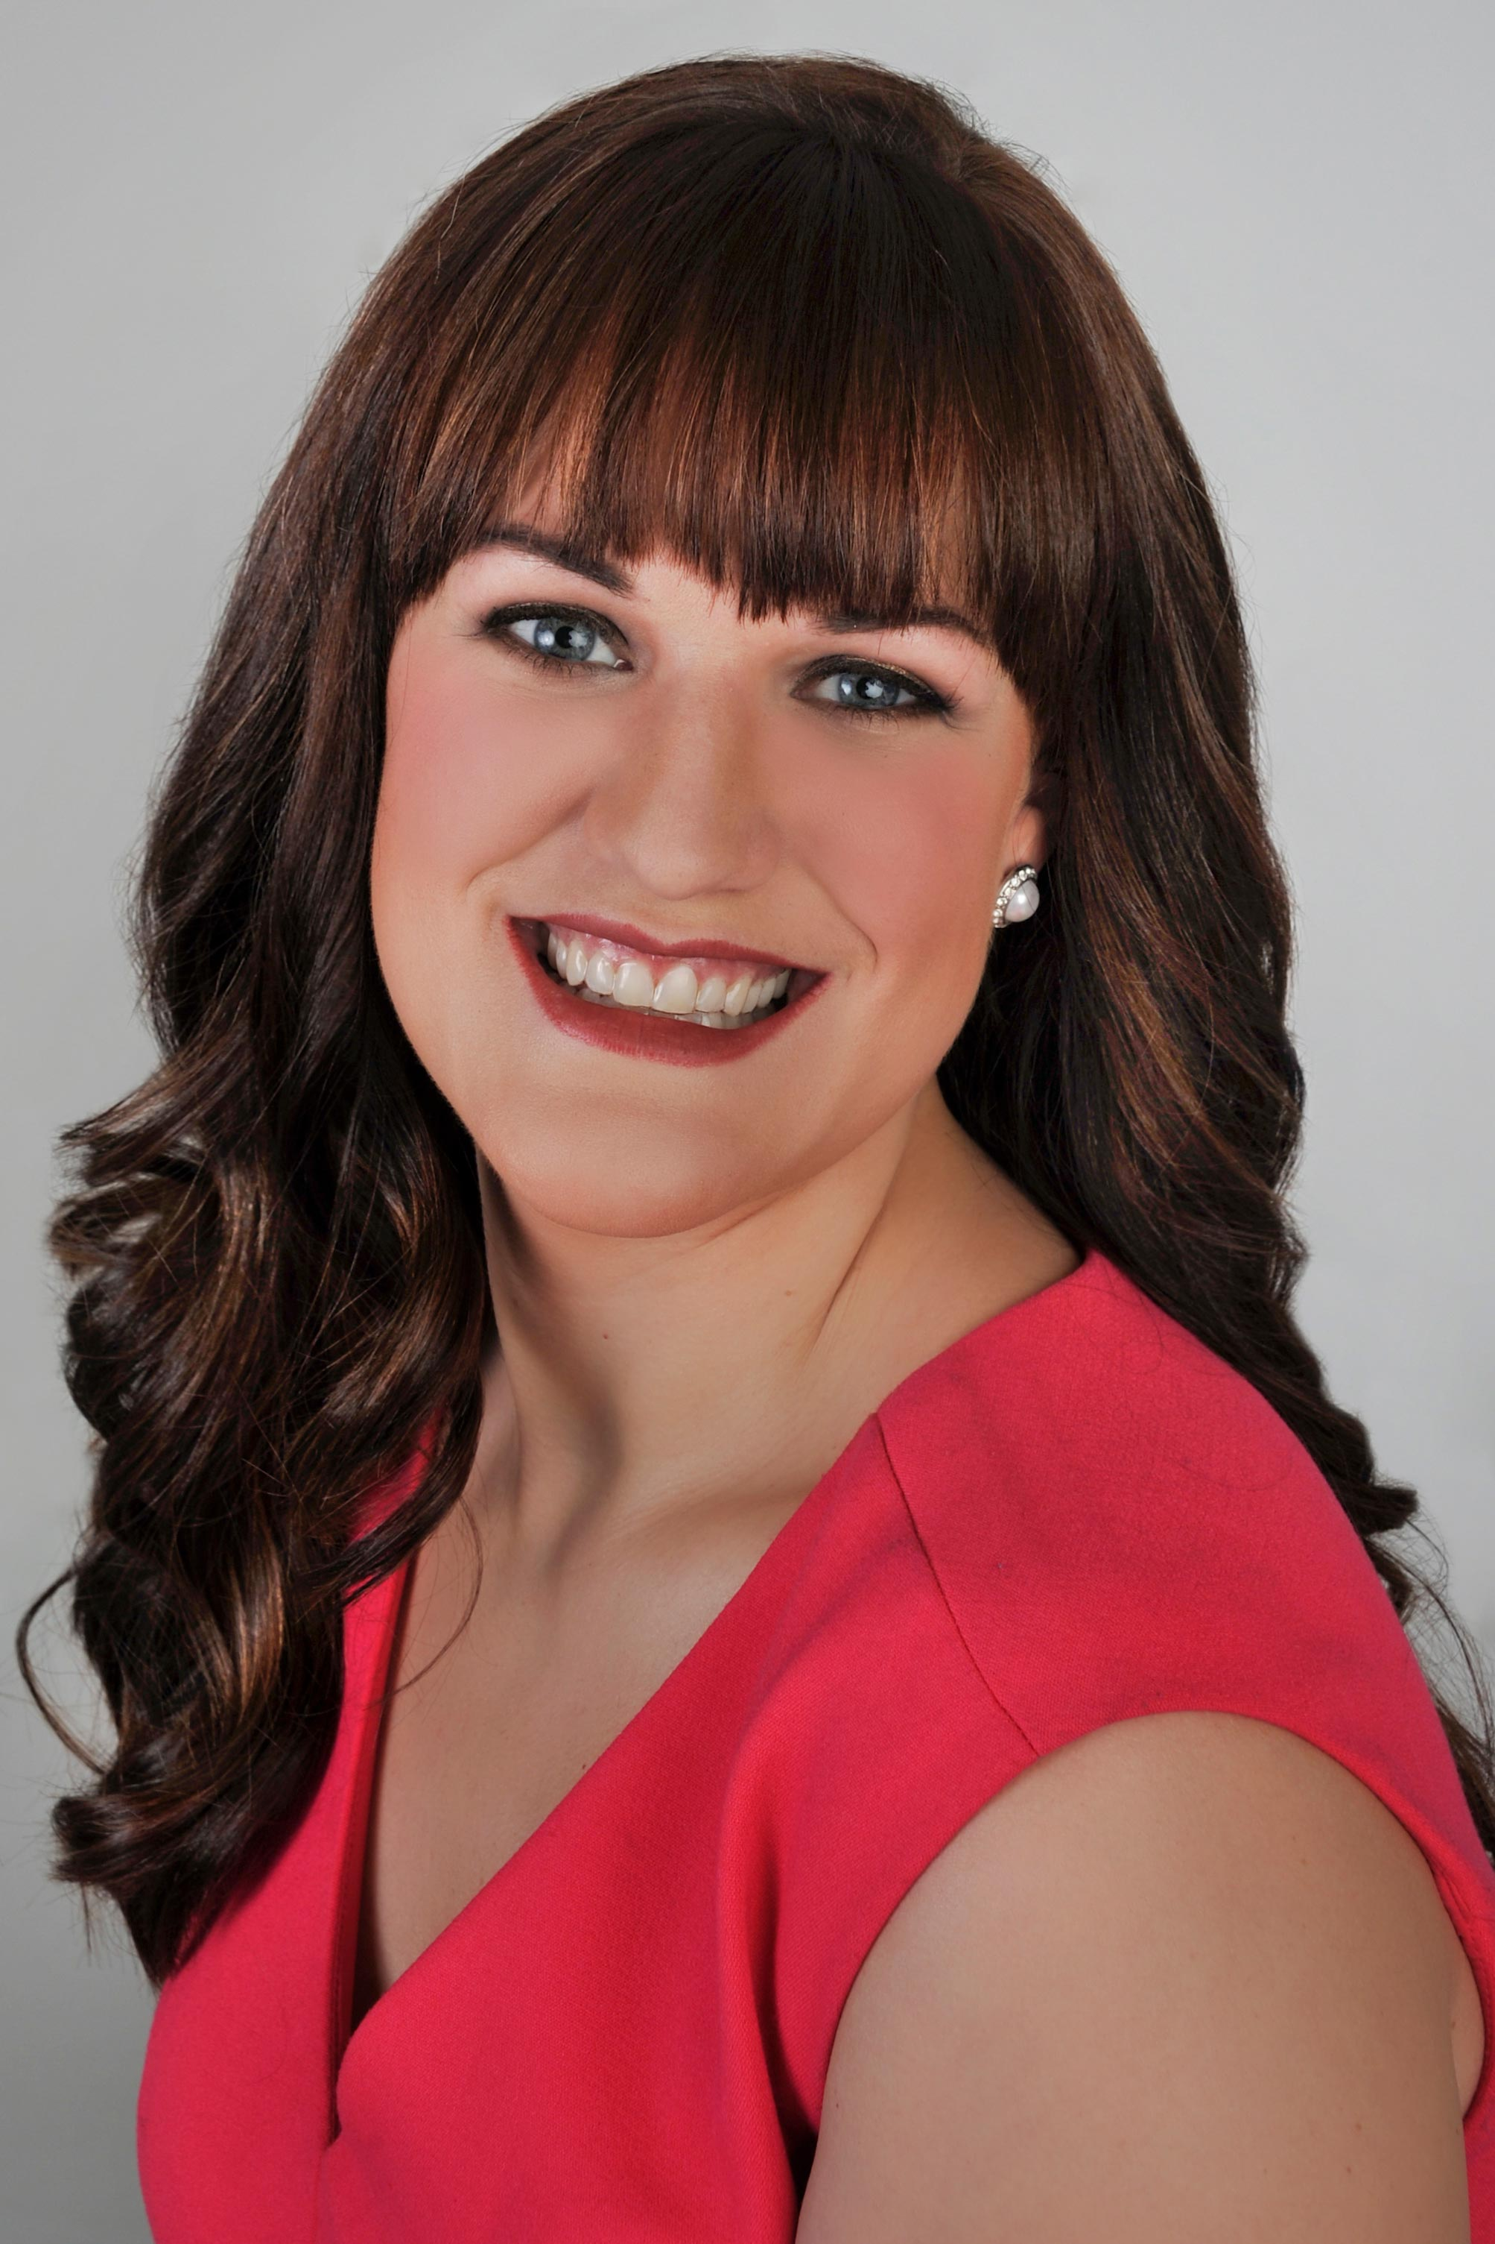
Strategic Doing Exercise
Led and Facilitated by…
ADAC’s Arctic C-ICE March 16-17: Day 2
1010-1145 AKDT/1410-1545 EDT
Margo Fliss
Manager of Strategic Engagement at the University of Alaska Center for Economic Development

Slide 7
Break
ADAC’s Arctic C-ICE March 16-17: Day 2
1145-1200 AKDT/1545-1600 EDT

Slide 8
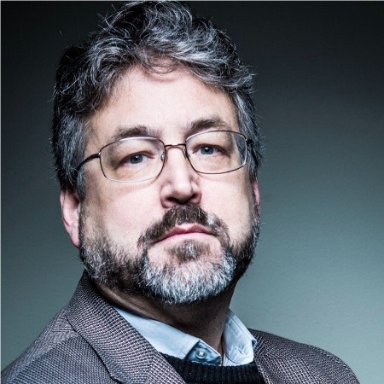
Final Keynote Presentation - The Future of Business in the Arctic: Innovation with Impact
Presented by…
ADAC’s Arctic C-ICE March 16-17: Day 2
1200-1245 AKDT/1600-1645 EDT
Hezekiah "Ky" Holland
Founding Partner of Alyeska Venture Management LLC, Owner of Holland Consulting, Creator, and Manager of the Alaska Accelerator Fund

Slide 9
On behalf of the University of Alaska and the Arctic Domain Awareness Center…
Thank You

